Slide 1
Supreme internect demo2 24/05/2019 taxi boss

Slide 2
Team members
Waldo van der Merwe (Team leader)
Joan Mwaniki (Main UI designer)
Brian Ndungu (Integration leader)
Duncan Smallwood (Database expert)
Dewald van Hoven (Scrum master)

Slide 3
client
Epi Use
Last meeting was on 16 May

Slide 4
Project overview
Taxis’ locations with their usual routes are displayed on the client screen
Commuters can request rides at designated pickup spots
Commuters can then rate taxis based on certain criteria
Commuters can follow a certain taxi driver
The owner of the taxi can monitor the driver’s behaviour on the road this way
Machine Learning will be used to send notifications to taxi drivers regarding reckless driving

Slide 5
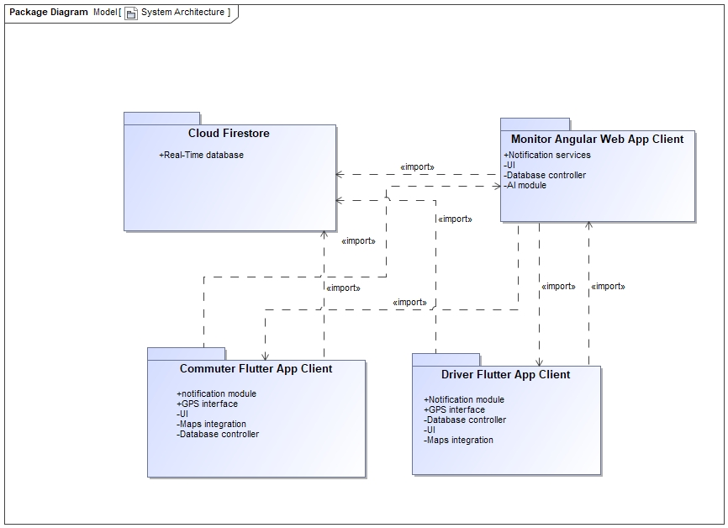
System architecture

Slide 6
Technologies used
Flutter UI Framework
Firebase Cloud Firestore for storing all data
Google Maps integration
Travis CI for continuous integration
Firebase Hosting
Angular

Slide 7
testing
Flutter test built in Unit Testing framework
Flutter test built in Widget Testing
Integration test with flutter driver
Mocha and Chai for Angular Unit testing

Slide 8
Coding standards

Slide 9
ci

Slide 10
Unit test

